Slide 1
The Unique Housing Patterns of the Asian Population in the United Kingdom
7CS034 – Data Science
School of Mathematics and Computer Science
Faculty of Science and Engineering
Coursework Assessment
Presented by
Moradeke Adeleye
2229810

Slide 2
Introduction
The UK has become more ethnically diverse in the past few decades (Warwick, 2022).
Data modified from the 2021 Population Census held in England was analysed using R tools(v1.2.1; Appelhans et al., 2015).
The unique housing patterns of the Asians stands out as a compelling narrative that is more than just spatial arrangements.
This report presents some interesting insights discovered using the data, shedding light on the interplay of culture, family life and economic realities within this community.
.
Notes:
How presentation will benefit audience: Adult learners are more interested in a subject if they know how or why it is important to them.
Presenter’s level of expertise in the subject: Briefly state your credentials in this area, or explain why participants should listen to you.

Slide 3
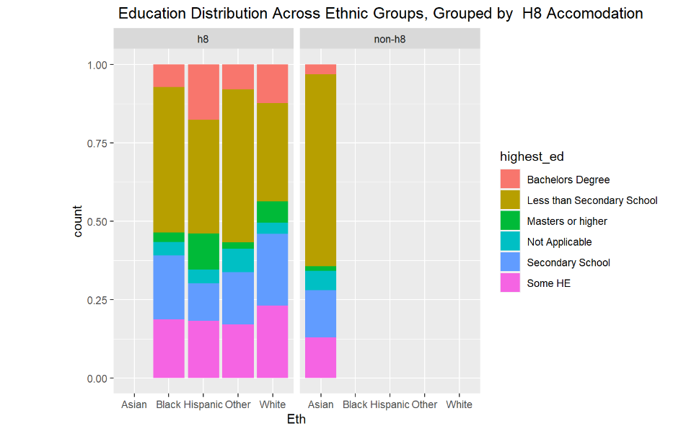

Living in Shared Spaces
This analysis illustrates the prevalent housing pattern among Asians in the UK, characterized by a shared usage of bathrooms, toilets, and kitchens with other households. This portrays a kind of communal living.
The Asians are known for their group-oriented practices, having a close-knit relationship. They have a cultural conception of family, and place great importance on the role of the extended family.
Moreover, for most ethnic minorities in the UK, it is practical to live in clusters that are relatively culturally homogenous (Jackson and Smith, 1981)

Slide 4
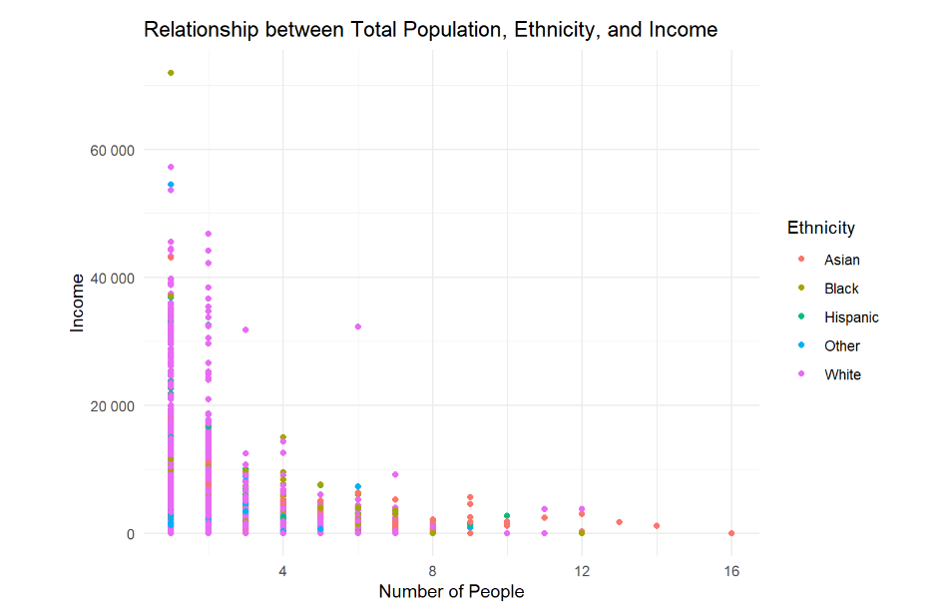
Large Households and Low Income
One of the striking revelations is that despite the
the rich family life of the Asians, it is apparent that there exists contrasting economic challenges.
Findings from the analysis reveal that the abundance of family members in Asian households contrasts greatly with their income. This can be attributed to the fact that most large households have quite a number of young children under 16 who don’t earn any income yet.
Asians have large households with up to 16 people living in a house. This implies high housing costs and lower standards of living.(Warwick and Mirza ,2023)
Notes:
Example objectives
At the end of this lesson, you will be able to:
Save files to the team Web server.
Move files to different locations on the team Web server.
Share files on the team Web server.

Slide 5
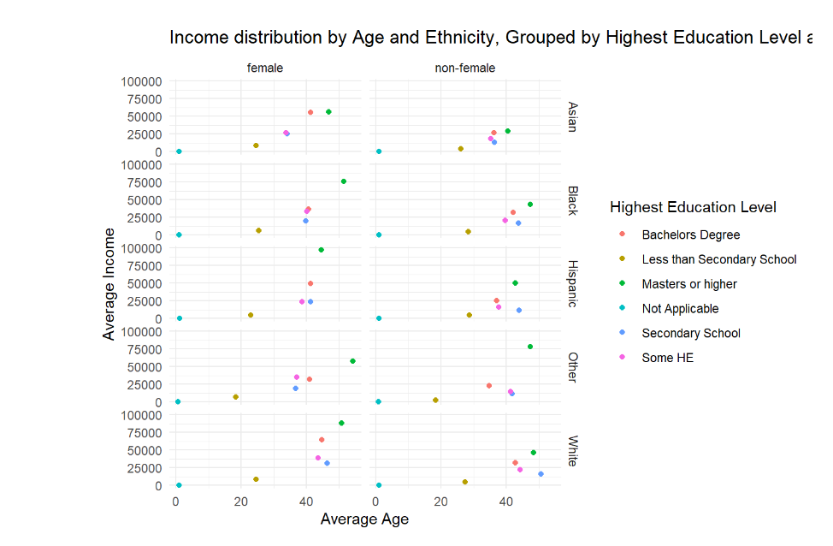
Households have more children
Asian households are filled with children who have educational qualification ‘less than secondary’ or in ‘secondary school’. The analysis shows that Asian households have up to 8 children per household.
This will definitely affect their income since they do not have so many people that earn an income in the household.
They have a small number of their population with Bachelors and Masters degree, and it is surprising to note that it is females with Bachelors and Masters degree that earn the most income.

Slide 6
Critique on Dataset Limitations
While the findings provide valuable insights, it's essential to acknowledge the limitations of the dataset in fully addressing the complexities surrounding Asian households in the UK.
Cultural and religious factors influencing housing choices and economic conditions were not captured in the dataset. Other factors include the migration history and class differences within the community (Institute of Race Relations, 2012).
Additionally, the data doesn’t encompass the full diversity within the Asian community. It doesn’t distinguish the different Asian groups. Asians are made up of a wide variety of groups which include Bangladesh, Pakistans, Chinese etc thus; oversimplifying the narrative.
Future research could benefit from a more detailed exploration of cultural nuances, socio-economic factors, and regional variations that contribute to the observed patterns.

Slide 7
References
Appelhans, T., Detsch, F., & Nauss, T. (2015). remote: Empirical Orthogonal Teleconnections in R. Journal of Statistical Software (Vol. 65, Issue 10, pp. 1–19). Available at: https://www.jstatsoft.org/article/view/v065i10 (Accessed:17 November 2023)
Institute of Race Relations (2012). BME statistics on poverty and deprivation . Available at: https://irr.org.uk/research/statistics/poverty/ (Accessed: 17 November 2023).
Jackson, P. and Smith, S. (1981) Social Interaction and Ethnic Segregation. Academy Press.
Warwick, R. and Mirza, H. S. (2023) Race and ethnicity. Institute for Fiscal Studies.

